Slide 1
ArcFace
By Saad Munir

Slide 2
Task Introduction
The primary task is to implement Additive Angular Margin Loss for Deep Face Recognition.
The given dataset contains 155 images only from LFW Dataset.
Usually, a deep Convolutional Neural Network is trained with traditional softmax loss.
Intuitively, embeddings of the same face should be mapped close to each other and embeddings of different faces should be more apart from each other.
This means that the projected faces should have small intra-class variance and large inter-class variance.
The softmax loss does not explicitly optimize the feature embeddings to enforce higher similarity for intra class samples and diversity for inter-class samples.
Drawback: Performance drop under large intra-class appearance variations (e.g. pose variations, age gaps).

Slide 3
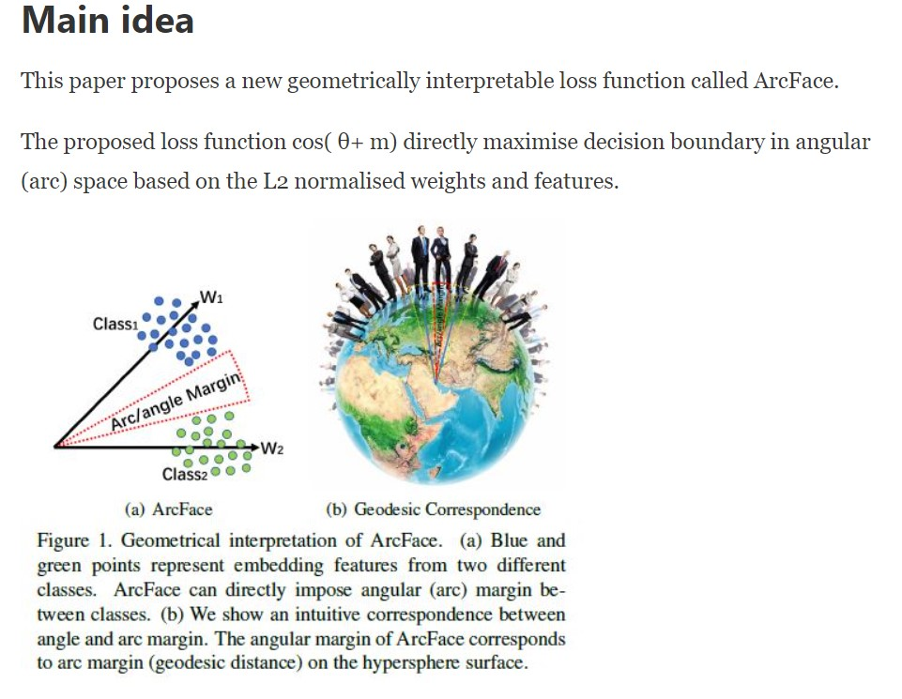
Solution: ArcFace

Slide 4
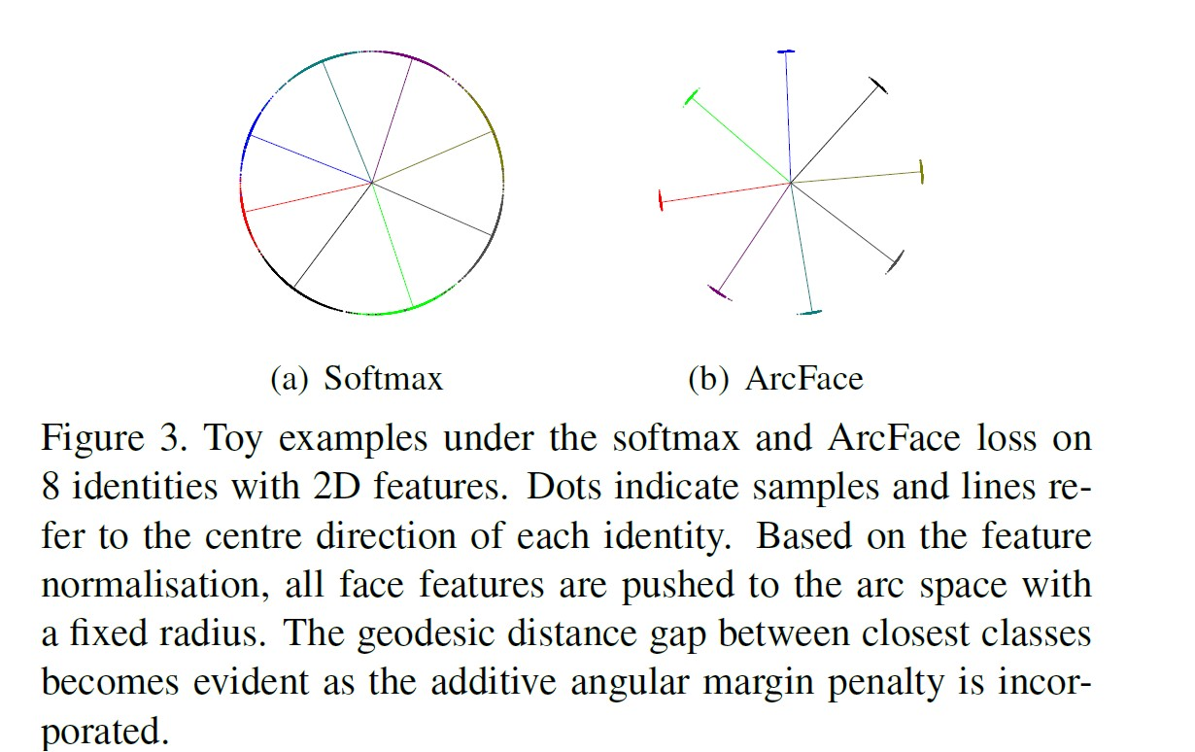
Visualization: Softmax and ArcFace
The pioneers of ArcFace selected face images from 8 different identities containing enough samples (around 1500 images/class) to train 2D feature embedding networks with the softmax and ArcFace Loss, respectively.

Slide 5
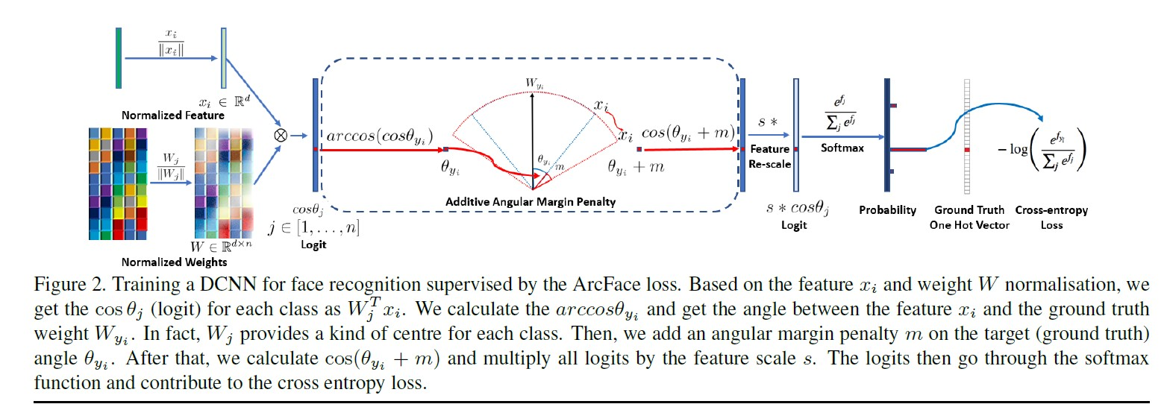
ArcFace Training

Slide 6
Data Pre-Processing
We have 155 RGB images with dimension of 250 X250X3.
18 classes (face categories).
I map each person name to a class index in a python dictionary such as {“Pervez_Musharraf”: 9}.
Originally, the images have pixels in the range [0, 255].
I scale the features(pixels) to lie in the range of [0, 1].
Due to small dataset, I only have the training set and validation set.
I use a train-validation split of 70% and 30%.
I create the train-validation split in a stratified fashion so that the validation set contains roughly 30% of images from each class.

Slide 7
Train using Transfer Learning
In the paper, the authors use pre-trained ResNet 50 and ResNet 100 models for feature extraction.
After the last convolutional layer and global pooling, the authors use BatchNorm-Fully Connected and Batch Norm to get a 512 Dimensional Feature Embedding.
I followed the same recommendations and use a pre-trained ResNet 50 model on ImageNet for Feature Extraction.
Then I used a Linear Layer to map the 2048 features into 512-D embedding.

Slide 8
ArcFace
I implemented the ArcFace as an Additional layer in PyTorch which takes in the feature embeddings and returns the projected logits.
Then , I extract the logits through ArcFace layer, pass them through the softmax function and compute the cross entropy loss.
The optimizer I used is Adam with learning rate of 1e-3 and it optimizes both the linear layer (2048->512) and the weights of the ArcFace layer.

Slide 9
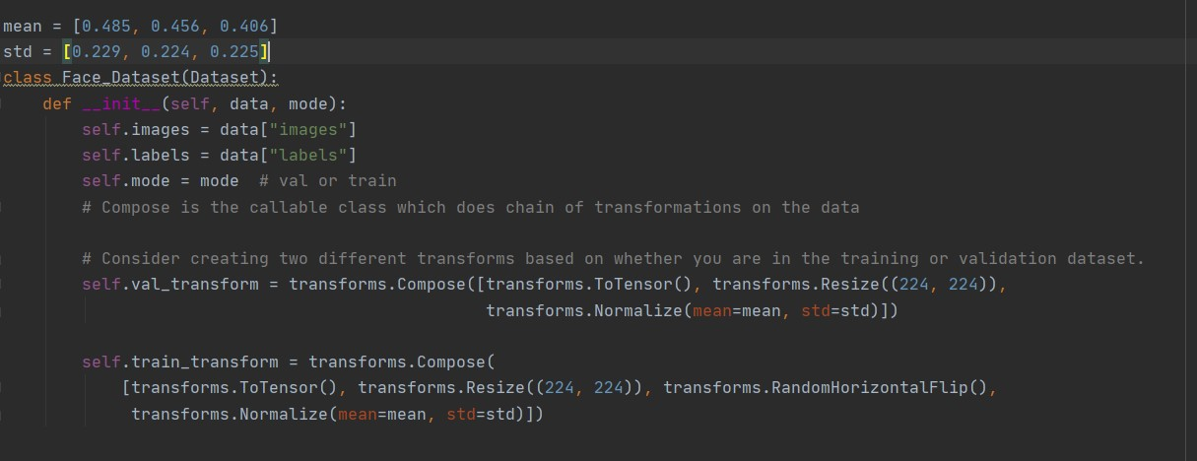
Additional Data Pre-Processing Steps
I normalize the images with the mean and standard deviation used for channel normalization in training ResNet 50 over ImageNet.
I use Random Horizontal Flip as a Data Augmentation Method in the training set.

Slide 10
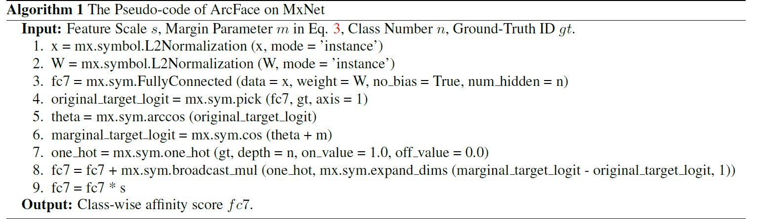
Implementation of Pseudocode in PyTorch
Pseudocode Given in Paper

Slide 11
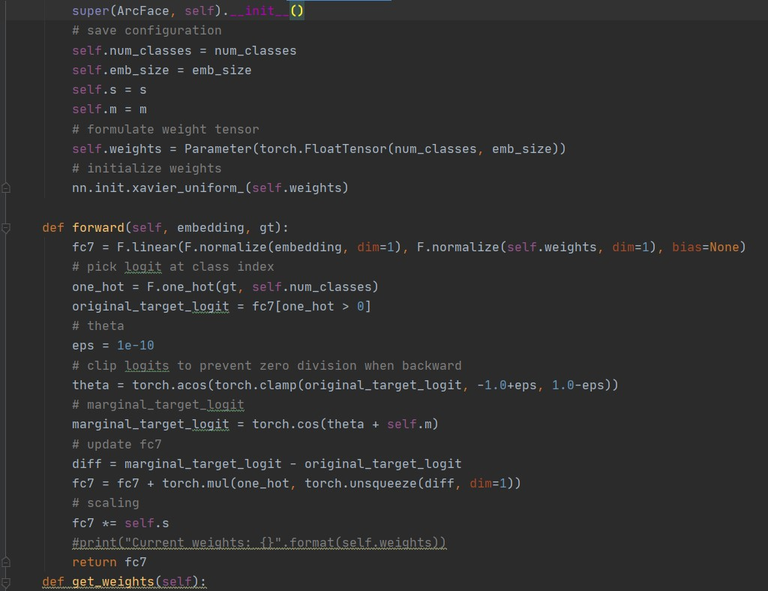
Implementation of Pseudocode in PyTorch

Slide 12
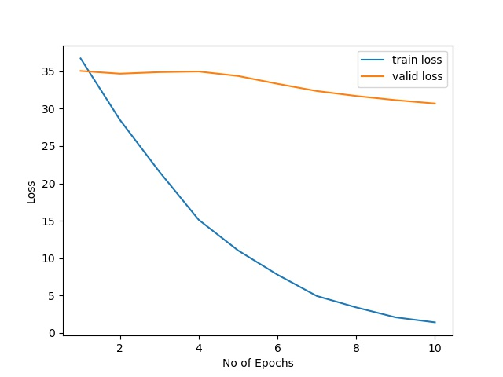
Results: ArcFace
The validation loss goes down but it should probably decrease more.

Slide 13
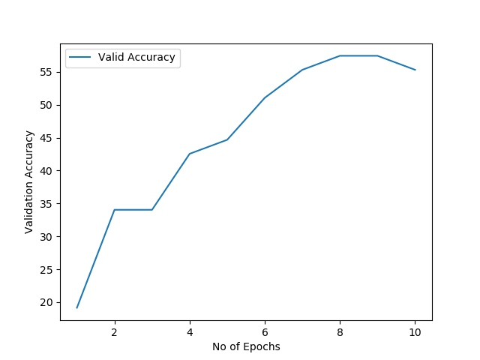
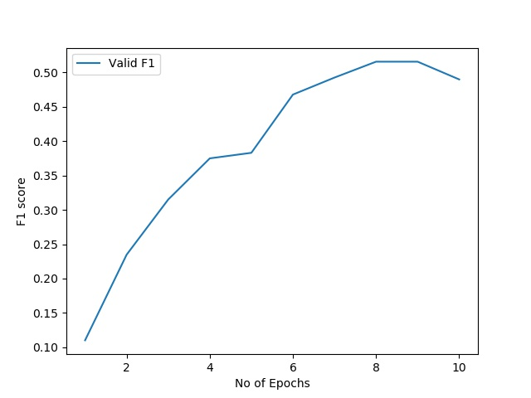
Results: ArcFace
Validation Accuracy
Validation Macro F1 Score

Slide 14
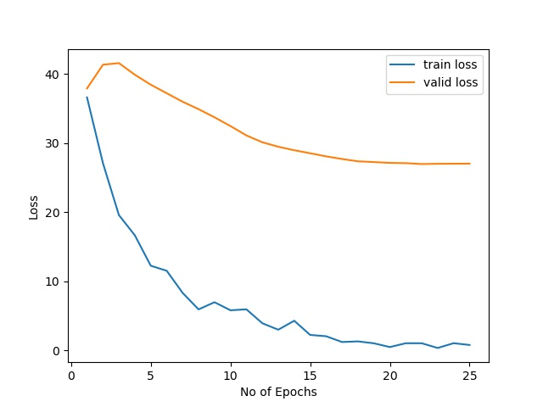
ArcFace with Balanced Mini-Batches
After handling class imbalance, the validation loss starts to decrease.

Slide 15
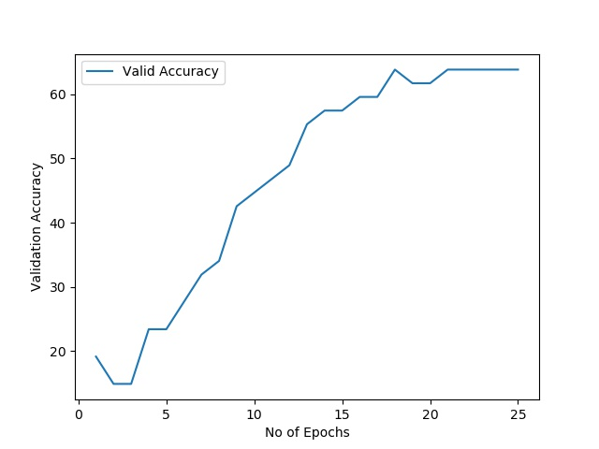
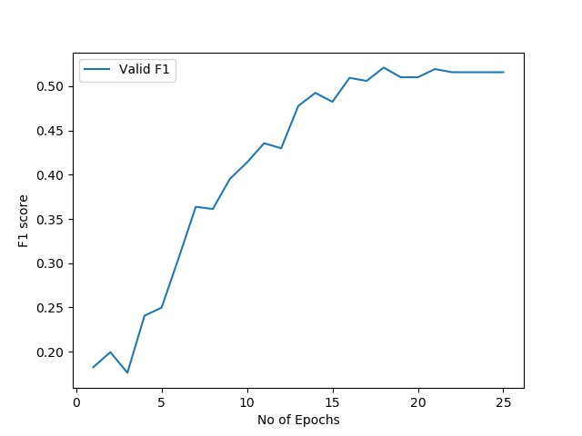
ArcFace with Balanced Mini-Batches
Validation Accuracy
Validation Macro F1 Score

Slide 16
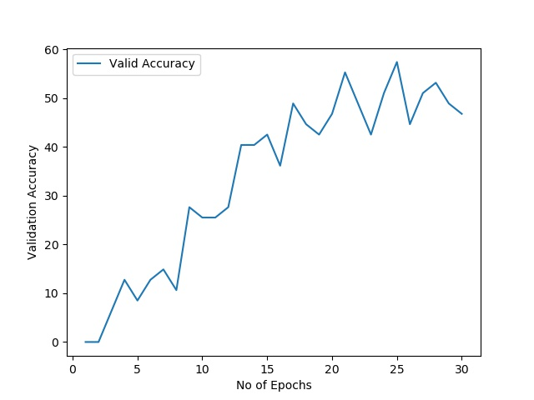
Conventional Cross-Entropy Loss vs ArcFace
ArcFace
Simple Cross Entropy

Slide 17
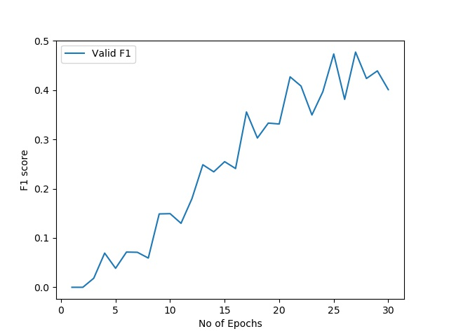
Conventional Cross-Entropy Loss vs ArcFace
ArcFace
Simple Cross Entropy

Slide 18
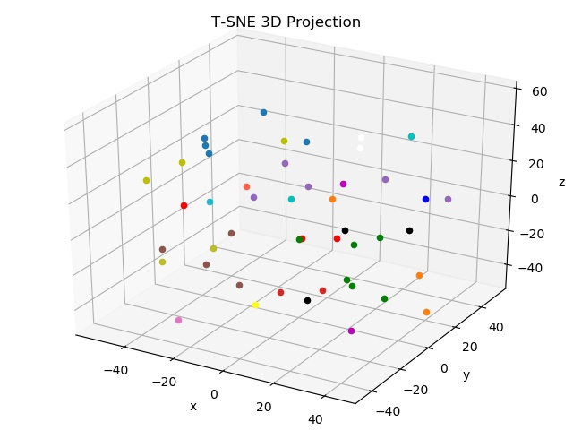
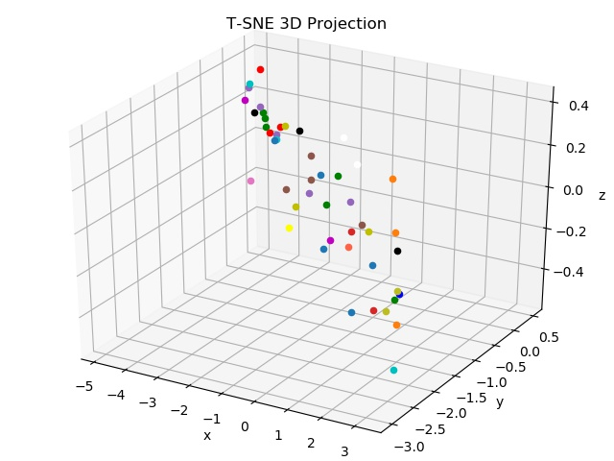
TSNE Feature Embedding Visualization
ArcFace
Simple Cross Entropy

Slide 19
Prediction during Inference
During inference, we only take the feature embedding without the last fully connected layer.
That means we take the 512 Dimensional Feature Embedding as output.
We then compute the cosine similarity of the feature embedding with the trained weights of the ArcFace Layer.
Each weight column of ArcFace Layer corresponds to a class centroid.
Choose the index of the class weight with the maximum cosine similarity.

Slide 20
Addition of New Class
With traditional losses, we need to retrain the whole model for adding an unknown class.
With ArcFace, we can add a new class without retraining the whole network.
Let us say we have 100 new images belong to an unknown class A.
We use multiple forward passes to compute the feature embeddings for each new image.
Then we can take the mean of the feature embeddings, which will approximate new class centroid.
Then, we can simply append the new class centroid to the Weight Matrix of ArcFace Layer.

Slide 21
Future Directions
Create and train a simple model from scratch.
Fewer parameters, less chances of overfitting.
Try to finetune the ResNet 50 model (Do not freeze weights).

Slide 22
Many Thanks for Listening!

